Slide 1

Transition Year :
Choosing Leaving Cert Subjects

Slide 2
When deciding on subjects, take into consideration:-
Student’s previous academic performance in Junior Cert.
DATS scores
Experience in Transition Year
Hobbies and Experience outside school
Percentage of subject assessed by a final exam
Meeting entry requirements for particular degrees
Most important of all, how interested is the student in the subject.

Slide 3
Subjects offered at DCW
English, Irish and Maths are compulsory –
French, German and Spanish
Physics, Chemistry and Biology
Economics, Accountancy and Business
History and Geography
Music, Home Economics and Art
LCVP
A student can choose to study extra subjects outside school, but it is the responsibility of the student and parent to ensure completion of coursework and to inform school if student is studying subject or dropping subject.

Slide 4
Leaving Certificate Vocational Programme
60% Portfolio – CV, Action Plan, Career Investigation, Summary Report, Video Interview, Work Experience Diary.
40% Exam in May
Student needs to be studying Irish and a Modern Language – unless exempt. Exposure to modern language acceptable. Does not need to sit exam.
Student must have a combination of VSG (Vocational Subject Groupings)
This information is available to student from Guidance Counsellor and can be found online.

Slide 5
Leaving Certificate Subject Choices
In Dominican College Wicklow we encourage students to take a Foreign Language and a Science subject.
This covers most Entry requirements for most courses.
Be aware that they need at least a H5 in Irish to become a Primary School Teacher
Be aware they will need Ordinary Level Maths to go into Nursing.*
*Or pass an Aptitude Test as a Mature Student

Slide 6
Leaving Certificate Subject Choices and Entry Requirements
Irish, English and Maths are entry requirements for the majority of third level degree courses. Trinity and some ITs allow you to present Foundation Level Maths.
NUI (National University of Ireland) colleges require a third language, except in Engineering, Science, Nursing and Agricultural Science
A small number of Science and Medical degree courses require a specific Science subject or two Sciences. Handouts are available.

Slide 7
How subjects are assessed and examined
Art –
Art History 37.5%, Life Drawing 12.5%, Still Life 25%, Craft 25%
Music – Students can opt for 25% or 50% practical assessment
Home Economics – Journal with 5 assignments 20%
History – Research Project 20% Written Exam 80%
Geography – Field Investigation 20% Written Exam 80%
French, German, Spanish –
Written Exam 55%, Listening 20%, Oral 25%

Slide 8
How subjects are assessed and examined: Part 2
Physics, Chemistry and Biology are assessed by a final exam worth 100%, BUT there are a series of laboratory experiments completed over the two years which are examined in the final paper.
Accountancy, Business and Economics are assessed by a final exam worth 100%, but much of the course content is very practical.
There is an additional subject called LCVP (Leaving Certificate Vocational Programme) with a portfolio worth 60% and a final exam in May worth 40%. Students need to be doing Irish, a Modern Language and a combination of two further subjects. Once students have chosen their main four subjects, we will be offering LCVP as an add on to their Leaving Certificate.

Slide 9
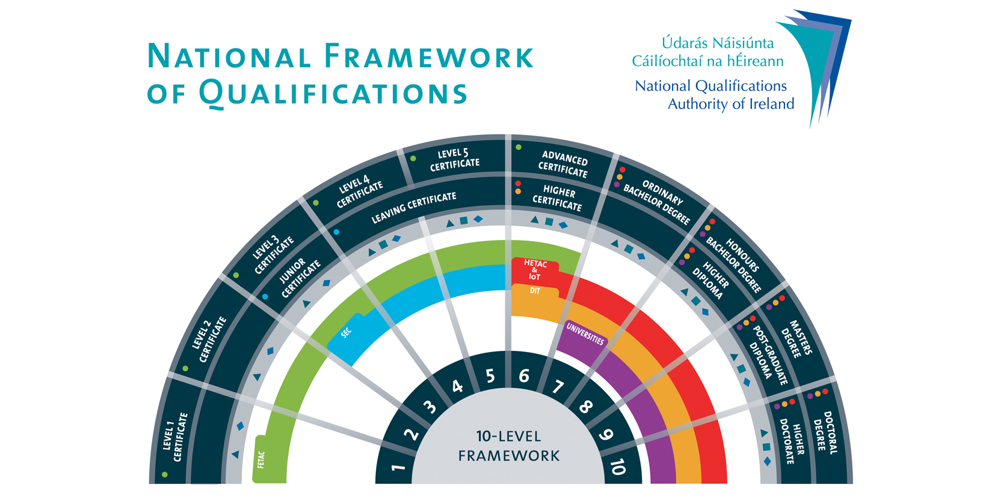
Levels

Slide 10
PLCs, ITs and Universities and Entry Requirements
Post Leaving Certificate Colleges offer one year or two year courses. You apply directly to the college and will be interviewed.
Check out Senior College Dun Laoghaire, Sallynoggin College, Bray Institute of Further Education.
Institutes of Technology require 2 Hons H5 and 4 Ordinary O6 or Honours H7 for an Honours degree (Level 8) and 5 Ordinary 06/H7 for an Ordinary degree (Level 7)Some ITs are now looking for one honours subject. Remember these are Entry Requirements, the points are much higher.
Trinity is the only university that requires 3 Hons H5 and 3 Ordinary 06 or Honours H7 for their degrees
*****Please note that specific degrees may require higher grades in certain subjects.

Slide 11
DARE – Disability Access Route to Education
If you apply via the CAO in 6th Year, you can fill out a DARE form if you have the following conditions:-
Attention Deficit Disorder (ADD)
Attention Deficit Hyperactivity Disorder (ADHD)
Autistic Spectrum Disorder (including Asperger’s Syndrome)
Blind/Vision Impaired
Deaf/Hard of Hearing
Development Coordination Disorder –Dyspraxia/Dysgraphia
Mental Health Conditions
Neurological Condition – Epilepsy and Brain Injury
Speech and Language Communication Disorder
Physical Disability
Significant Ongoing Health Issue
Specific Learning Difficulty inc. Dyslexia and Dyscalculia

Slide 12
DARE
If a student is accepted on the DARE scheme, they will be able to enter a degree on slightly reduced points. The reduction in points differs from college to college.
Not all colleges participate on the DARE scheme
Section A filled out online via CAO form,
Section B: Educational Impact filled out with Guidance Counsellor.
Section C Medical Evidence, you may need a consultant report.

Slide 13
Lifelong Learning
Think about life as a process of acquiring skills.
(Driving License, Languages, Computers)
Even now a student may have an idea of what they enjoy doing – inside and outside school.
Build a skills base to make themselves more employable or to build a business.
School only looks at a tiny range of subjects. Colleges and universities are full of weird and wonderful degree titles.

Slide 14
What will they learn if they study these?
Biochemistry, Astronomy, Immunology, Genetics, Astrophysics, Botany, Geology, Zoology.
Visual Communications, Digital Media, Games Development, Forensic Computing
Social Care Practice, European Studies, Horticulture
Culinary Arts, Heritage Studies, Podiatry, Anthropology, Aeronautical Engineering
Check out college websites, go to Open Days, look at the course content in a degree, Erasmus exchanges, work placement, career opportunities

Slide 15
Where do I go next?
Click like on Facebook pages
Buy newspapers for the Education pages.
Do interest inventory on Careers Portal website – www.careersportal.ie
Research third level courses at www.qualifax.ie
Check out college websites
Consult guidance counsellor –anestmason@dominicanwicklow.com

